Slide 1

Apache ServiceMix
Dima Ionut Daniel

Slide 2
Contents
What is Apache ServiceMix?
Architecture
ESB
Features
Apache Camel
JBI
Apache Karaf
Apache ActiveMQ
Apache Cxf
Apache Aries
Activiti
SOA
Core
Conclusions
Bibliography

Slide 3

What is Apache ServiceMix?
ServiceMix is an open-source distributed enterprise service bus (ESB) based on the service-oriented architecture (SOA) model.
It is a project of the Apache Software Foundation and was built on the semantics and application programming interfaces of the Java Business Integration (JBI) specification JSR 208.
The software is distributed under the Apache License.

Slide 4
What is Apache ServiceMix? (cont.)
The productized and supported release of ServiceMix 4 is from JBoss and called Fuse ESB.
The current version of ServiceMix fully supports the OSGi framework.
ServiceMix is lightweight and easily embeddable with integrated Spring Framework support.
It is composed the latest versions of Apache ActiveMQ, Apache Camel, Apache CXF, and Apache Karaf.

Slide 5
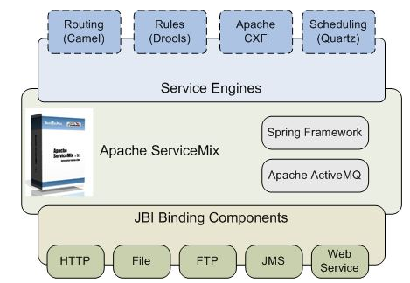
Architecture

Slide 6
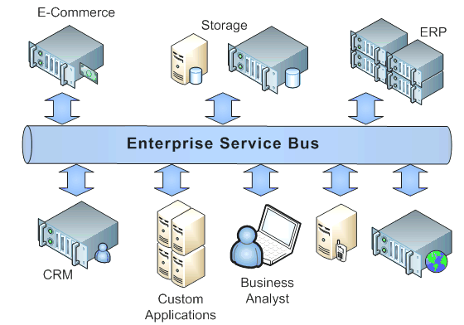
ESB
An enterprise service bus (ESB) is a centralized, logical, architectural component that operates in a distributed, heterogeneous environment to facilitate the requirements of a highly scalable, fault-tolerant, service-messaging framework.
An ESB acts as an open and implementation-independent service messaging and interfacing model that isolates application code from the specifics of routing services and transport protocols.

Slide 7
Features
Apache Felix Karaf
Apache Camel
Apache ActiveMQ
NMR implementation
Compliance with the JBI specification JSR 208
BPM engine via Activiti
JPA support via Apache OpenJPA
XA transaction management via JTA via Apache Aries

Slide 8
Features (cont.)
Clustering and container provided failover
Hot deployment and lifecycle management of business objects
Vendor independence from vendor-licensed products
Compliance with the OSGi 4.2 specification through Apache Felix.
Support for OSGi Enterprise through Apache Aries

Slide 9
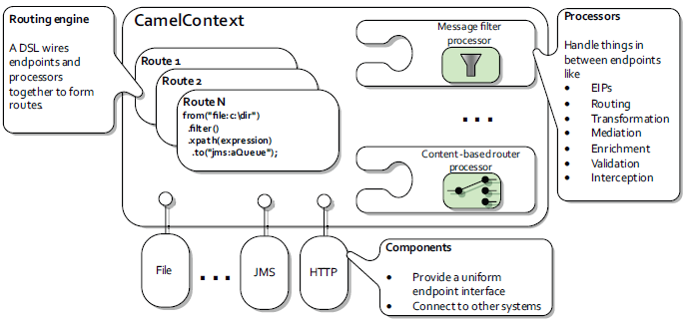
Apache Camel
Open-source mediation and routing
Based on Enterprise Integration Patterns
Routes are defined in: Java DSL, Spring XML DSL, Scala DSL

Slide 10
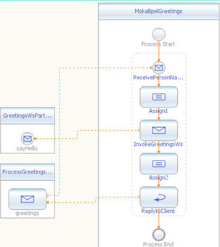
JBI
Java Business Integration (JBI) is defined under JSR-208.
Pluggable architecture for integration systems
Components interoperate through mediated message exchange
It is based on the WSDL message exchange model

Slide 11
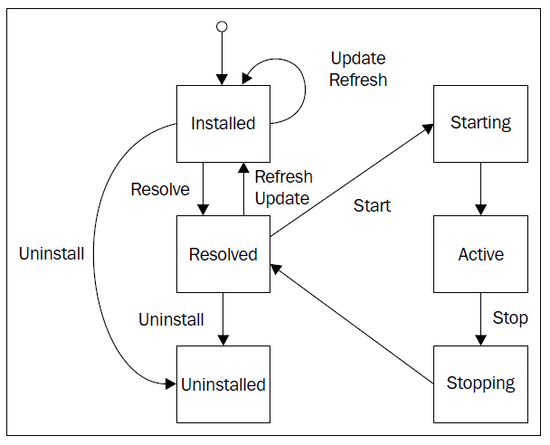
Apache Karaf
Apache Karaf is an opensource subproject of Apache Felix.
Apache Karaf, as an OSGI runtime container handles OSGI bundle lifecycle.

Slide 12
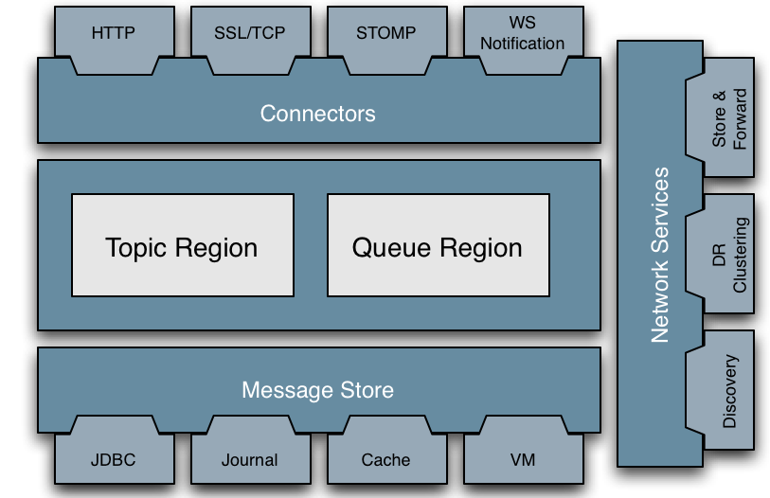
Apache ActiveMQ
ActiveMQ is an open source message broker written in Java.
ActiveMQ contains a full JMS(Java message Service) client.

Slide 13
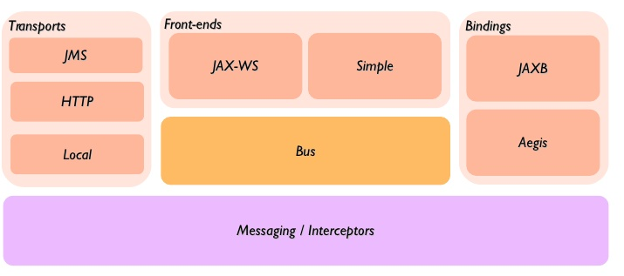
Apache Cxf
CXF is an open-source services framework that you can use to suit your WS-* standards integration needs.
We can use programming APIs like JAX-RS or JAX-WS for building services and to expose them.
We can use CXF from within your Camel routes with the Camel CXF component.

Slide 14
Apache Aries
The Aries project consists of a set of pluggable Java components enabling an enterprise OSGi application programming model
It implements enterprise extensions OSGi specifications:
Asynchronous Services and Promises Specification
Blueprint Specification
JTA Transaction Services Specification
JMX Management Model Specification
JNDI Services Specification
JPA Service Specification
Service Loader Mediator Specification
Subsystem Service Specification

Slide 15
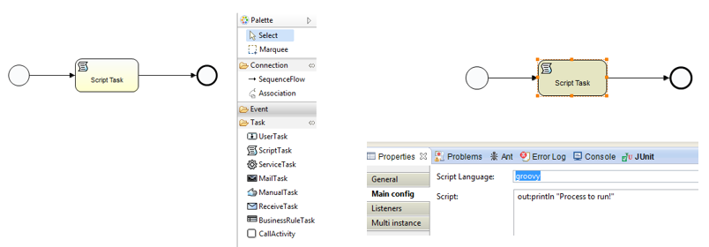
Activiti
Activiti is a BPMN 2.0 process-engine framework that implements the BPMN 2.0 specification.
The Activiti Engine is a state machine.

Slide 16
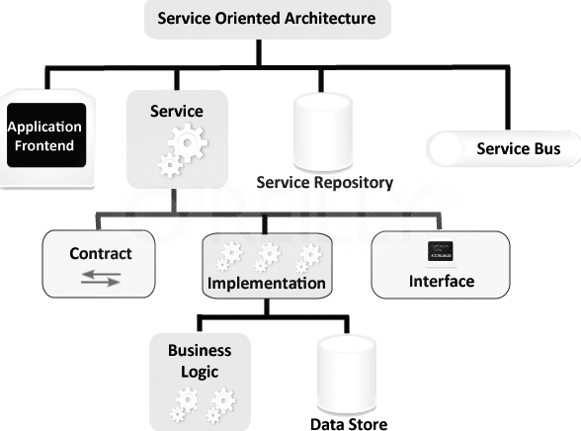
SOA
SOA is an underlying computer systems structure that supports the connection between various applications and the sharing of data.
Service-oriented architecture (SOA) helps the business processes be better, easier to change and cheaper to create.

Slide 17
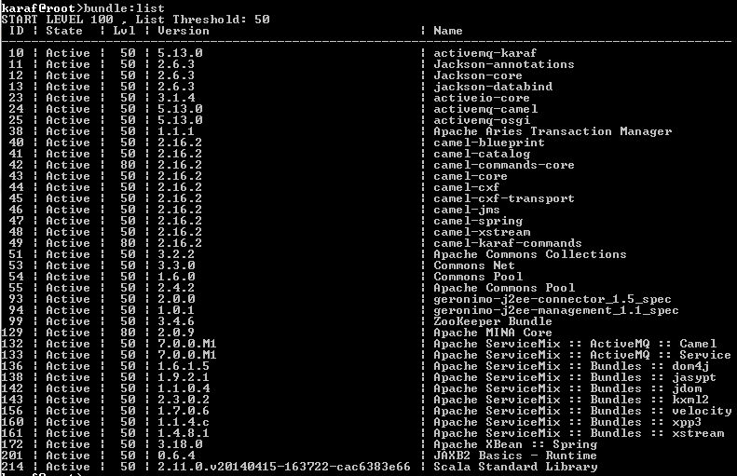
Core
After service mix is started we can use the console to run commands:

Slide 18
Core (cont.)
For every bundle, you have bellow information:
the bundle id
the bundle state
the bundle start level
the bundle name and version

Slide 19
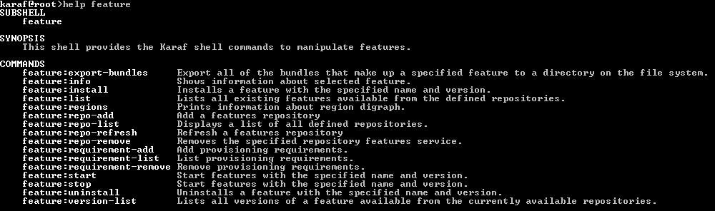
Core (cont.)
To verify the features installed we can use the feature:list command.
We can install new features using feature:install.

Slide 20
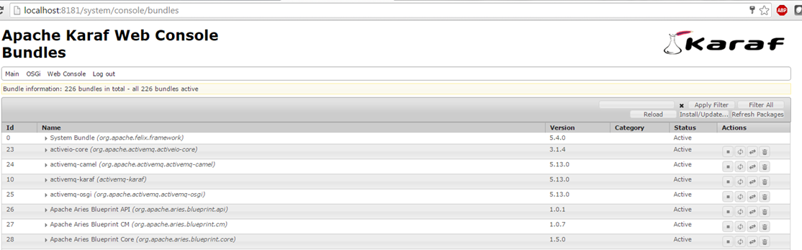
Core (cont.)
The webConsole is a usefull tool to check the OSGI bundles.
We need to use the smx/smx as user/password for log in.

Slide 21
Conclusions
Can be used as EAI(Enterprise Application Integration)
Provides a large set of features and services.

Slide 22

Bibliography
https://en.wikipedia.org/wiki/Apache_ServiceMix

